Slide 1
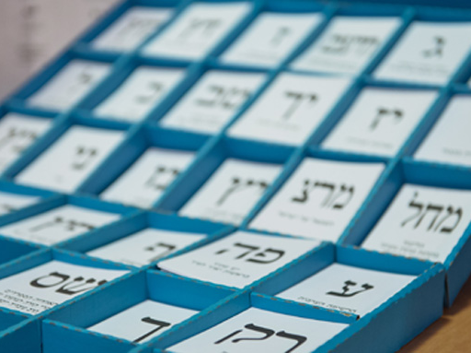
Summary of Arab Vote to the 24th Knesset Elections (March 2021) (Source of data: Knesset Central Elections Committee)
Compiled by Dr. Arik Rudnitzky
Israel Democracy Institute, Jerusalem

Slide 2
The 24th Knesset Elections in Numbers
44.6%
Overall turnout in Arab and Druze localities
80 : 20
Breakdown of the votes for Arab parties vs. Jewish parties
½ seat
Arab sector’s support of the Likud

Slide 3
Election Turnout, 1999-2021

Slide 4
Participation of Arab Citizens in the Elections, 2019-2021

Slide 5
Breakdown of Arab Vote in Knesset Elections, 1999-2021 *
* Including lists that did not pass the electoral threshold; Data refers to the vote in Arab and Druze localities only, excluding Arab inhabitants in mixed cities, double envelopes and the rest of the country.

Slide 6
Breakdown of Eligible Arab Voters in Knesset Elections, 1999-2021 *
* Including lists that did not pass the electoral threshold; Data refers to the vote in Arab and Druze localities only

Slide 7
Arab Parties’ Achievements in the 24th Knesset Elections
167,064 votes
4 seats

Slide 8
Arab Parties’ Achievements in Knesset Elections, 2019-2021
379,647 votes
10 seats
581,507 votes
15 seats
470,211 votes
13 seats
337,108 votes
10 seats

Slide 9
Breakdown of the Votes for Arab Parties, 24th Knesset Elections
The United Arab List: 167,064 votes
The Joint List: 212,583 votes

Slide 10
Breakdown of the Vote in Arab and Druze Localities | Turnout 44.6%
* Including lists that did not pass the electoral threshold

Slide 11
Breakdown of the Arab vote in the North of the Country | Turnout 46.9%
* Including lists that did not pass the electoral threshold

Slide 12
Breakdown of the Bedouin Vote in the North of the Country | Turnout 39.2%
* Including lists that did not pass the electoral threshold

Slide 13
Breakdown of the Vote in Druze Localities | Turnout 46.4%
* Including lists that did not pass the electoral threshold

Slide 14
Breakdown of the Vote in Christian Localities | Turnout 54%
* Including lists that did not pass the electoral threshold

Slide 15
Support of Arab Parties, Northern Region, 2019-2021 Elections

Slide 16
Breakdown of the Vote in the Triangle Region – Overview | Turnout 40.0%
* Including lists that did not pass the electoral threshold

Slide 17
Breakdown of the Vote in the Southern Triangle | Turnout 46.6%
* Including lists that did not pass the electoral threshold

Slide 18
Breakdown of the Vote in the Northern Triangle | Turnout 35%
* Including lists that did not pass the electoral threshold

Slide 19
Breakdown of the Vote in the Jerusalem Area| Turnout 42.4%
* Including lists that did not pass the electoral threshold

Slide 20
Breakdown of the Negev Bedouin Vote – Overview | Turnout 42.3%
* Including lists that did not pass the electoral threshold

Slide 21
Breakdown of the Vote in Negev Bedouin Townships | Turnout 45.8%
* Including lists that did not pass the electoral threshold

Slide 22
Breakdown of Bedouin Vote in Negev Regional Councils | Turnout 50.5%
* Including lists that did not pass the electoral threshold

Slide 23
Breakdown of the Vote of Negev Bedouin Tribes | Turnout 32.4%
* Including lists that did not pass the electoral threshold

Slide 24
Turnout of Arab Residents in Mixed Jewish-Arab Cities

Slide 25
Turnout of Arab Voters in Mixed Cities: 23rd, 24th Knesset Elections

Slide 26
Arab Votes to Jewish Parties – March 2021 Elections *
36,200 votes = 1 seat
* The data refer to the vote of Arab citizens in Arab and Druze localities only. These figures do not include the vote of Arab residents living in mixed Jewish-Arab cities or in different localities throughout the country, or votes in double envelopes.

Slide 27
Jewish Parties’ Achievements in the Arab sector, 2019-2021 Elections *
* The data refer to the vote of Arab citizens in Arab and Druze localities only. These figures do not include the vote of Arab residents living in mixed Jewish-Arab cities or in different localities throughout the country, or votes in double envelopes.

